Slide 1
Database project
Neta Ben Mordechai, 211451901
Itay Chabra, 208292458

Slide 2
Description of original program
The original Java program was designed to manage a collection of questions and answers, allowing users to interact with these elements through various operations such as adding, deleting, and displaying questions and answers. The primary focus was on creating and manipulating different types of questions (e.g., American and Open questions) and organizing them within repositories. A key feature of the program was the ability to generate exams from the existing questions in a repository. Users could create two types of exams: an automatic exam, where a specified number of questions were randomly selected, and a manual exam, where users could manually choose the questions to include. The program used collections like arrays and lists to store and manage the questions, answers, and exams. This setup provided a flexible way to handle user input, validate choices, and generate exams without the need for a database, relying solely on in-memory data structures to perform all operations.

Slide 3
requirements
The database for the project serves to manage and organize questions, answers, and exams within repositories. It supports various functionalities including:
CRUD Operations: Ability to create, read, update, and delete repositories, questions, answers, and exams.
Question and Answer Management: Store, categorize, and manage different types of questions (open-ended and multiple-choice) and their associated answers.
Exam Creation: Generate exams that can be either automatically created with random questions or manually configured by users.
Data Integrity: Maintain relationships between questions, answers, and repositories through foreign key constraints and database triggers, ensuring referential integrity and efficient data retrieval.

Slide 4
users of the system
The users of the system are people who need to manage a collection of questions and generate exams. These could include:
Teachers:
Create and manage repositories.
Add, update, and delete questions and answers.
Create and manage exams.
Students:
Take exams generated by the system.
Review the solutions.

Slide 5
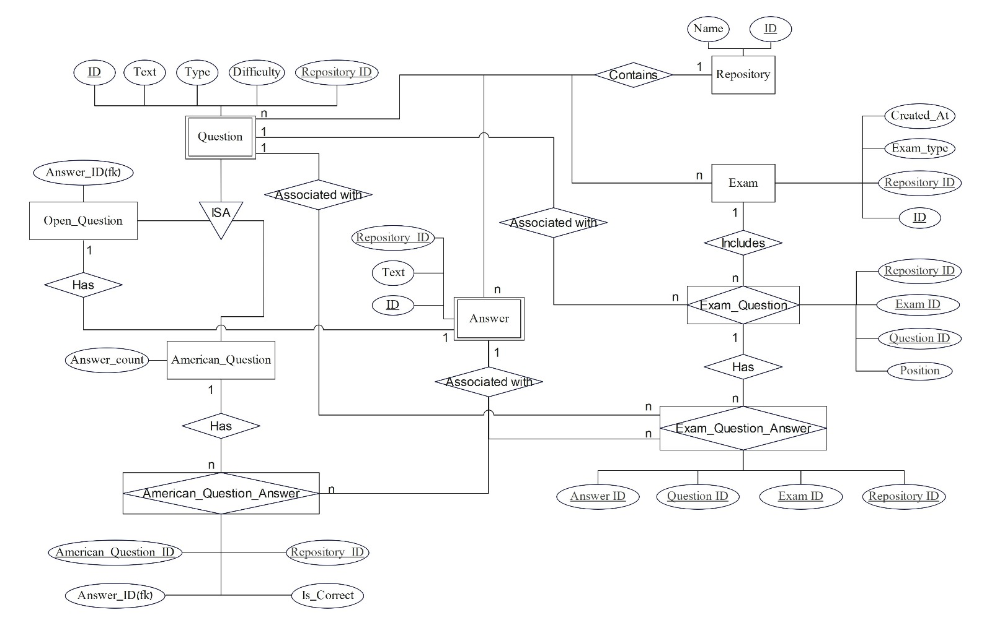
erd

Slide 6
Table layout
Repository(Id, Name)
Question(Id, Repository_id*(FK), Difficulty, Text, Type)
*Reference Repository
Answer(Id, Repository_Id*(FK), Text)
*Reference Repository
Open_Question(Questotion_Id*(FK), Repository_Id**(FK), Answer_Id***(FK))
*Reference Question
**Reference Repository
***Reference Answer

Slide 7
Table layout
American_Question(Question_Id*(FK), Repository_Id*(FK), Answer_count)
*Reference Question
**Reference Repository
American_Question_Answer(American_Question_Id*(FK), Repository_Id**(FK), Answer_Id***(FK), Is_Correct)
*Reference American_Question
** Reference Repository
***Reference Answer
Exam(Id, Repository_Id*(FK), Exam_Type)
*Reference Repository

Slide 8
Table layout
Exam_Question(Exam_Id*(FK), Repository_Id**(FK), Question_Id***(FK), Position)
*Reference Exam
**Reference Repository
***Reference Question
Exam_Question_Answer(Exam_Id*(FK), Repository_Id**(FK), Question_Id***(FK), Answer_Id****(FK))
*Reference Exam
**Reference Repository
*** Reference Question
**** Reference Answer

